Slide 1

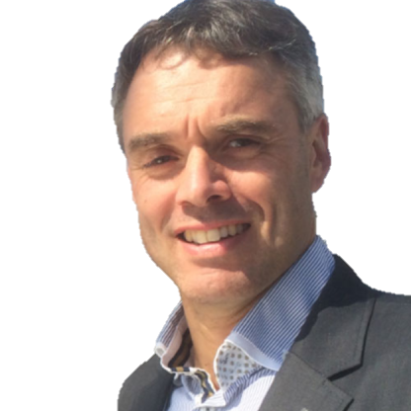
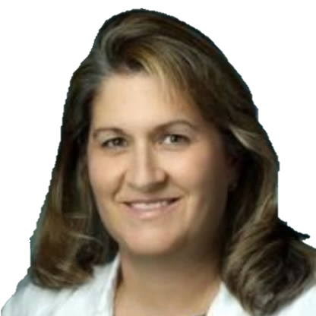







The International Achondroplasia Forum presents
Shaping the Future of Care in Achondroplasia and Related Conditions 2026
11th September 2026, Radisson Blu Hotel, Marseille, France
Join leading experts for a dedicated conference focused on shaping the future care in short stature conditions and improving patient outcomes
Chaired by:
Latest treatment insights
Explore current and emerging therapies, including clinical trials and approved options
Practical clinical guidance
Learn real-world strategies to optimise patient management
Overcoming challenges
Address key barriers in diagnosis, treatment, and long-term care
Expert perspectives
Hear from leading clinicians sharing experience and best practice
Dr Svein Fredwall
Dr Julie Hoover-Fong
Submit your abstract here!
Register now!

Slide 2
The International Achondroplasia Forum presents
Shaping the Future of Care in Achondroplasia and Related Conditions 2026
11th September 2026, Radisson Blu Hotel, Marseille, France
Time | Session |  | Who
08:30 | Coffee and arrivals
09:00 | Welcome to IAF 2026 |  | Svein Fredwall and Julie Hoover-Fong
09:15 | Diagnosing achondroplasia: From prenatal suspicion to early childhood |  | Julie Hoover-Fong
09:40 | Diagnosing hypochondroplasia |  | Moira Cheung
10:05 | Early diagnosis of achondroplasia and hypochondroplasia in practice |  | All, led by faculty
10:35 | Coffee break
10:50 | Understanding functional outcomes and QoL |  | Penny Ireland
11:20 | Breakouts (35 minutes, 5 minutes moving time)
 | Challenges of sleep-disorded breathing in achondroplasia: Led by Brigitte Fauroux | Physiotherapy, functional outcomes and QoL in achondroplasia: Led by Penny Ireland | Weight management and lifestyle in achondroplasia: Led by Moira Cheung
12:00 | Lunch Industry-sponsored session (45 mins)
Time | Session |  | Who
13:00/ 13:40 | Breakouts (2 rotations, attendees to attend all breakouts)
 | Challenges of sleep-disorded breathing in achondroplasia: Led by Brigitte Fauroux | Physiotherapy, functional outcomes and QoL in achondroplasia: Led by Penny Ireland | Weight management and lifestyle in achondroplasia: Led by Moira Cheung
14:20 | Coffee break
14:35 | Expanding medical treatment options in achondroplasia and related conditions |  | Ravi Savarirayan
15:15 | Orthopaedic interventions in achondroplasia: Advances and decision-making |  | Keita Okada
15:45 | Coffee break
16:00 | Abstract session |  | Svein Fredwall and Mohamad Maghnie
16:30 | Unknowns and unanswered questions in skeletal dysplasia management |  | All faculty
17:00 | Industry-sponsored session
17:45 | Summary |  | Svein Fredwall and Julie Hoover-Fong
18:00 | Meeting close and departures

